Slide 1
Websocket
Websocket is a communication protocol.
WebSocket is designed to be more efficient and responsive than traditional HTTP communication.
Websocket use ws:// or wss:// scheme.
wss:// is for a secure Websocket.
It is a stateful protocol.
Example - ws://example.com:8000/ws/chat

Slide 2
Websocket provide full duplex communication.
1) Half-duplex (One way communication) (Like HTTP)
Client → request → Server
Client ← response ← Server
2) Full-duplex (Two way communication) (Like Websocket)
Client → request → Server
Client → handshake ← Server
(connection is open until client or server close the connection).

Slide 3
HOW TO INSTALL WEBSOCKETS ?
The Websocket package is a Python library for building WebSocket servers and clients.
pip install websockets

Slide 4
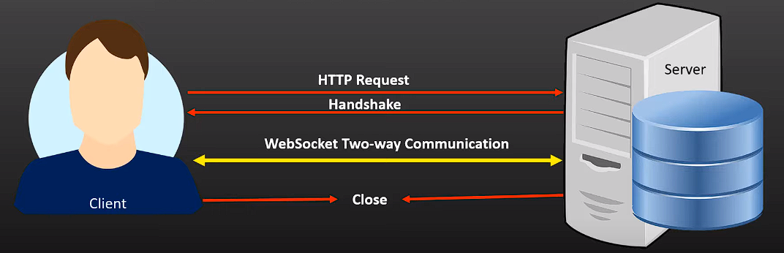
How Websocket Works
Client send regular HTTP request with additional header to be requested.
The server get HTTP request & notice that the request is for upgrade header.
This let the server know the we are requesting Websocket connection.
Connection can be closed either by client or server.

Slide 5
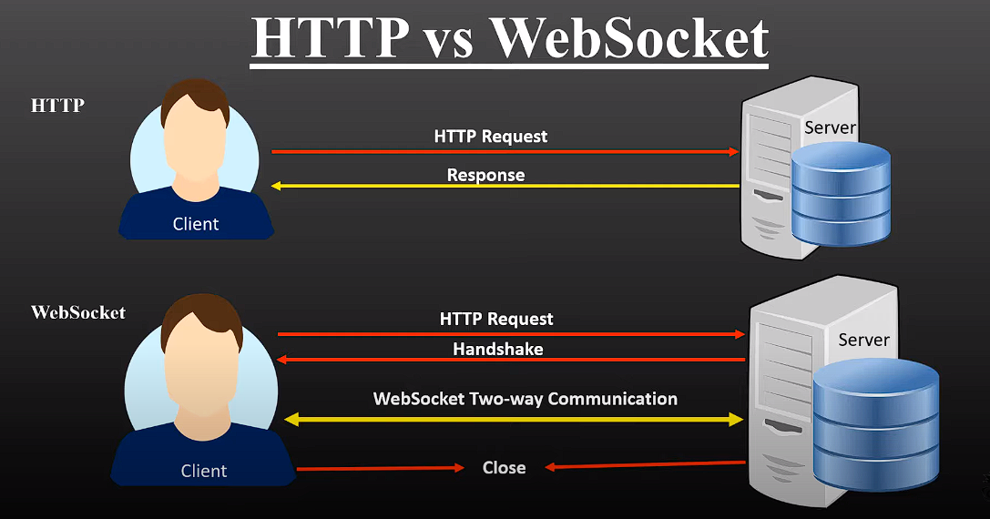
HTTP v/s Websocket

Slide 6
What can we build
Chat Application (WhatsApp, Messenger)
Real-time Web Application
Notification
Trading (Binance)
Location Based Application (OLA, Uber, Zomato, Swiggy)
Real-time Data Visualization (YouTube Stream)
Online Gaming

Slide 7
Difference Between HTTP & Websocket
HTTP | Websocket
HTTP = Hypertext Transfer Protocol HTTPS = Hypertext Transfer Protocol Secure | WS = Websocket WSS = Websocket Secure
Each request from the client to the server and the corresponding response is a separate connection. | WebSocket establishes a persistent connection between the client and the server.
HTTP is slower ! | Websocket is faster !
HTTP is suitable for most web applications, including traditional websites and RESTful APIs. | WebSocket is used for applications that require real-time, interactive communication, such as chat, online gaming, live dashboards, and collaborative tools.
HTTP can be secured using HTTPS (HTTP over TLS/SSL) to encrypt the data transmitted between the client and server. | WebSocket connections can also be secured using the same security mechanisms as HTTPS.

